Slide 1
PRAVEEN KUMAR S Project

Slide 2
HAND WRITTEN DIGIT RECOGNITION USING
GENERATIVE ADVERSARIAL NETWORK
3/21/2024 Annual Review

Slide 3


OUTLINE
Objective
Real time application
Generator and discriminator
Problem Statement
Generative Adversarial Network
Proposed System/Solution
System Development Approach
Algorithm and Deployment
Result
Conclusion
References
3/21/2024 Annual Review

Slide 4

GENERATIVE ADVERSARIAL NETWORK
A Generative Adversarial Network (GAN) is a class of machine learning frameworks introduced by Ian Goodfellow and his colleagues in 2014.
GANs are composed of two neural networks, a generator and a discriminator, which are trained simultaneously through adversarial training.
GANs have been used for a variety of applications, including image generation, style transfer, super-resolution, and more.
3/21/2024 Annual Review

Slide 5
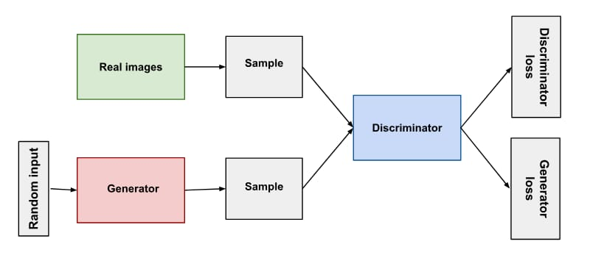

GAN ARCHITECTURE
3/21/2024 Annual Review

Slide 6

OBJECTIVE
The main objective of a Generative Adversarial Network (GAN) is to generate new data that is similar to a given dataset.
GANs consist of two neural networks, a generator and a discriminator, which are trained simultaneously in a competitive manner.
The generator learns to produce data that is indistinguishable from the real data, while the discriminator learns to differentiate between real data and data generated by the generator.
Through this adversarial process, the generator improves its ability to create realistic data, leading to the generation of high-quality synthetic data.
3/21/2024 Annual Review

Slide 7

REAL TIME APPLICATION
Image Editing and Augmentation*
Medical Image Analysis
Text-to-Image Synthesis
Drug Discovery
Video Generation and Prediction
Anomaly Detection
Style Transfer in Fashion
Image Generation
3/21/2024 Annual Review

Slide 8

GENERATOR
The generator in a Generative Adversarial Network (GAN) is a neural network that takes random noise as input and generates synthetic data samples.
It learns to map this noise to the data distribution of the training set, effectively creating new data that is similar to the real data.
3/21/2024 Annual Review
8

Slide 9
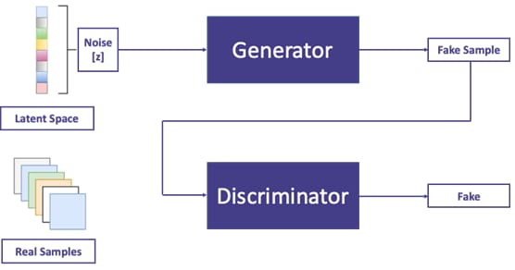
3/21/2024 Annual Review
9

Slide 10
DISCRIMINATOR
The discriminator in a Generative Adversarial Network (GAN) is a neural network that learns to distinguish between real data and data generated by the generator
It takes input data, either real or generated, and produces a binary output indicating whether the input is real or fake.
Demo Link
3/21/2024 Annual Review
10

Slide 11
PROBLEM STATEMENT
"Inefficient handwritten text recognition persists due to the scarcity of diverse datasets and the complexity of individual writing styles. To address this, leveraging Generative Adversarial Networks (GANs) offers a promising avenue. Our project aims to harness GANs to generate realistic handwritten characters, facilitating data augmentation for improved model training. By bridging the gap between synthetic and real-world handwritten samples, our approach seeks to enhance the accuracy and robustness of handwritten text recognition systems. Through this research, we aim to revolutionize handwritten text processing, enabling more efficient and accurate recognition across various applications and industries."

Slide 12
PROPOSED SYSTEM:
Proposed system involves the development of a Handwritten Text Generation Model using Generative Adversarial Networks (GANs). This system aims to address the challenge of generating realistic handwritten characters to augment training datasets for handwritten text recognition tasks. The GAN architecture will consist of a generator network trained to produce synthetic handwritten characters and a discriminator network trained to distinguish between real and synthetic samples. The model will be trained on a diverse dataset of handwritten characters to ensure the generation of realistic and diverse handwritten text samples.

Slide 13
PROPOSED SOLUTION:
Problem solution:
Introduce the problem of handwritten text recognition, highlighting challenges such as variability in handwriting styles and limited annotated data.
Overview of GANs:
Provide an overview of Generative Adversarial Networks (GANs), explaining how they consist of two neural networks, a generator, and a discriminator, competing against each other to generate realistic data.
3.Data Collection and Preprocessing:
Discuss the importance of collecting a diverse dataset of handwritten characters and preprocessing steps such as normalization and augmentation to improve model performance

Slide 14
4.GAN Architecture Design:
Detail the architecture of the GAN model, including the generator responsible for generating synthetic handwritten characters and the discriminator trained to distinguish between real and synthetic samples.
5.Training Process:
Explain the training process of the GAN model, emphasizing the adversarial training approach where the generator learns to produce realistic handwritten characters while the discriminator learns to differentiate between real and synthetic samples.

Slide 15
6.Training Process:
Explain the training process of the GAN model, emphasizing the adversarial training approach where the generator learns to produce realistic handwritten characters while the discriminator learns to differentiate between real and synthetic samples.
7.Evaluation and Validation:
Discuss evaluation metrics such as visual inspection of generated samples, quantitative measures of similarity to real data, and feedback from human evaluators to validate the performance of the trained GAN model.

Slide 16
8.Integration with Handwritten Recognition Systems:
Explore how the generated handwritten characters can be integrated into existing recognition systems to augment training data, improving the system's accuracy and robustness.
9.Benefits and Applications:
Highlight the benefits of using GANs for generating synthetic handwritten data, including improved model generalization, reduced data annotation costs, and enhanced performance in applications such as document digitization and signature verification.

Slide 17
SYSTEM APPROACH:
Hardware Requirements:
High-performance CPU or CPU cluster.
GPU accelerator with CUDA support for deep learning computations.
Sufficient RAM and storage capacity.
Fast storage for efficient data access.
High-speed networking infrastructure for data transfer.

Slide 18
SYSTEM APPROACH:
Software Requirements:
. TensorFlow or PyTorch for GAN implementation.
Python programming language for scripting.
CUDA Toolkit and cuDNN library for GPU acceleration.
Development environment such as PyCharm or Jupyter Notebook.
Version control with Git and collaboration platforms like GitHub.
Containerization with Docker for environment management.
Testing tools like PyTest and visualization libraries for monitoring and analysis.

Slide 19
ALGORITHM:
Here's a concise algorithm for a Handwritten Model using GAN:
1.Initialize Parameters: Set hyperparameters and define network architectures for generator and discriminator.
2.Data Pre-processing: Normalize and augment handwritten character images.
3.Define Generator and Discriminator: Implement generator to produce synthetic handwritten characters. Implement discriminator to classify real vs. synthetic characters.

Slide 20
4.Training Loop: Train discriminator to distinguish real from synthetic characters.Train generator to fool discriminator into producing realistic characters.
5.Evaluation: Assess generated characters using evaluation metrics.Fine-tune model if necessary.
6.Integration with Recognition System (Optional): Integrate generated characters with recognition system for training data augmentation.

Slide 21
DEPLOYMENT:
1. Model Training:
Train the GAN model on a high-performance computing (HPC) system using GPUs for accelerated training.
2. Model Optimization:
Optimize the trained model for inference speed and resource efficiency.
3.Containerization:
Package the optimized model into a Docker container for easy deployment and portability.

Slide 22
4.Deployment Platform:
Choose a deployment platform such as cloud services (e.g., AWS, Azure) or on-premises servers.
5.Scalability Considerations:
Ensure the deployment infrastructure can handle varying workloads and scale horizontally if needed.
6.API Integration (Optional):
Expose the GAN model through an API for seamless integration with other systems or applications.

Slide 23
7.Monitoring and Maintenance:
Implement monitoring tools to track model performance and resource utilization. Regularly update the deployed model with improvements or new versions as needed.
8.Security Considerations:
Implement security measures such as access control and encryption to protect the deployed model and data.
9.Testing and Validation:
Conduct thorough testing to ensure the deployed model performs as expected in a production environment.

Slide 24
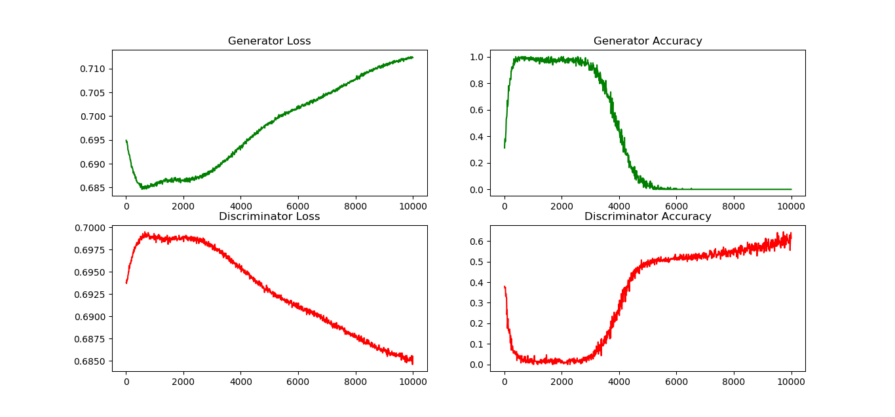
RESULT:

Slide 25
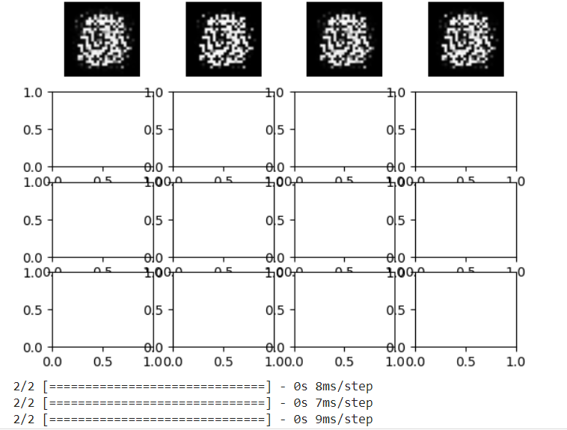
RESULT:

Slide 26
CONCLUSION:
In conclusion, the use of Generative Adversarial Networks (GANs) for handwritten model generation offers promising advancements in the field of handwriting recognition. By leveraging GANs, we can generate realistic synthetic handwritten characters, thereby augmenting training datasets and improving the accuracy and robustness of recognition systems. Despite challenges such as data variability and model optimization, the deployment of GAN-based handwritten models holds immense potential in various applications, including document digitization, signature verification, and language translation. With continued research and refinement, GANs have the capability to revolutionize handwritten text processing, paving the way for more efficient and accurate recognition across diverse handwriting styles and languages.

